Slide 2
Problem Statement
Uncovering the core issues that hinder progress and innovation

Slide 3


Problem & Solution
Addressing the core challenges with strategic interventions.
The Problem
The Solution
Inefficient Workflows
Automated Processes
Manual, repetitive tasks drain resources and slow down execution.
Implement smart automation to streamline operations and boost productivity.
Fragmented Data
Unified Data Platform
Siloed information leads to inconsistent reporting and missed opportunities.
Centralize data for comprehensive insights and informed decision-making.
Stalled Innovation
Agile Development
Rigid processes and lack of experimentation hinder new product development.
Foster a culture of rapid prototyping and continuous improvement.

Slide 4
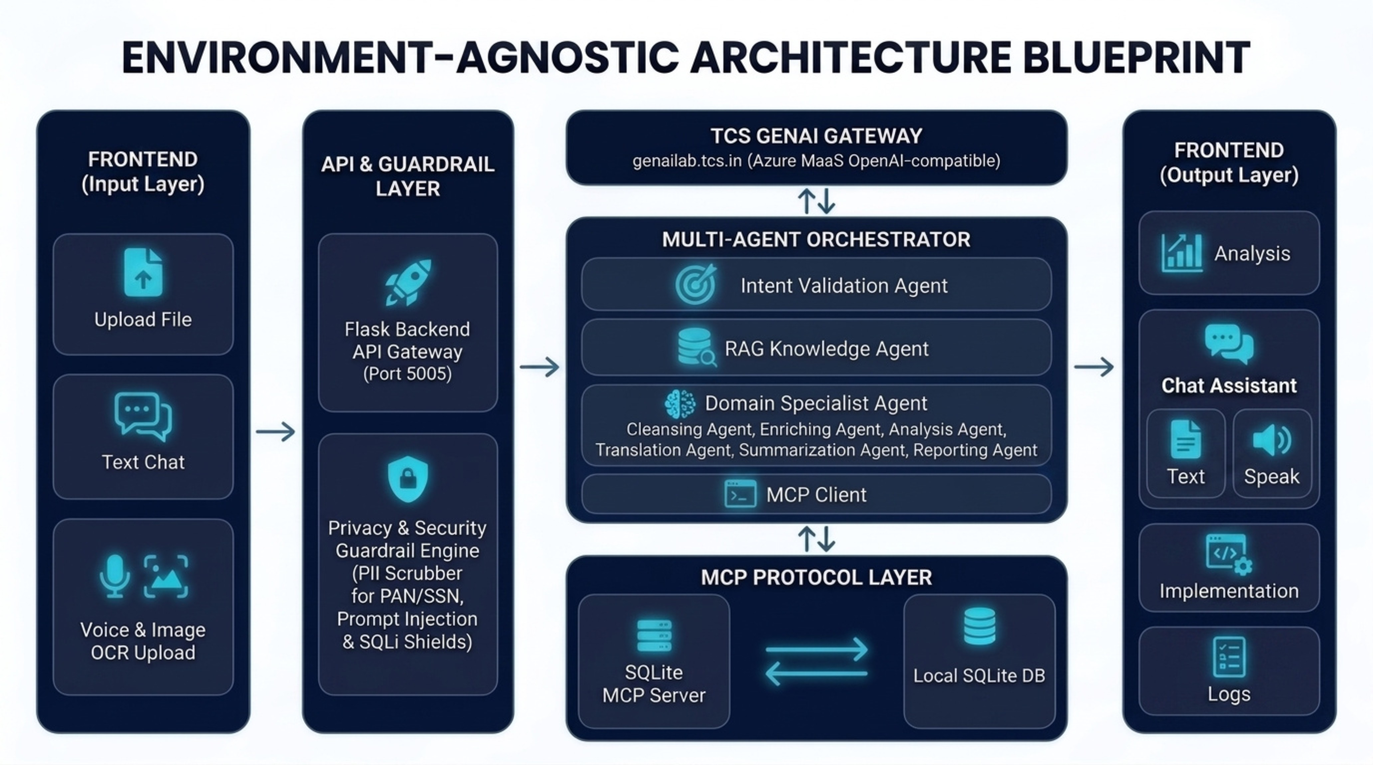

Slide 5
Thank You
Let's connect and build the future together.
info@yourcompany.com | +1 123-456-7890 | yourcompany.com

